Slide 1
Chapter 4: Threads & Concurrency

Slide 2
Not part of OS Syllabus
Volatile keyword: tells the compiler that variable might change at any moment due to some external influence (such as hardware or another thread). Therefore, the compiler should not optimize based on the assumption that the variable will remain constant.
Static keyword:
When used inside a function to declare a variable, it creates a variable that retains its value between function calls. These variables are initialized only once before the program starts execution and they retain their value throughout the program's execution. Static local variables are not visible to functions in other files.
When used outside of functions, it declares a variable that is accessible only within the file where it is declared. These variables are visible only within the file where they are declared, meaning they cannot be accessed by functions in other files. Static global variables have a file scope, which means they are accessible from the point of their declaration to the end of the file.

Slide 3
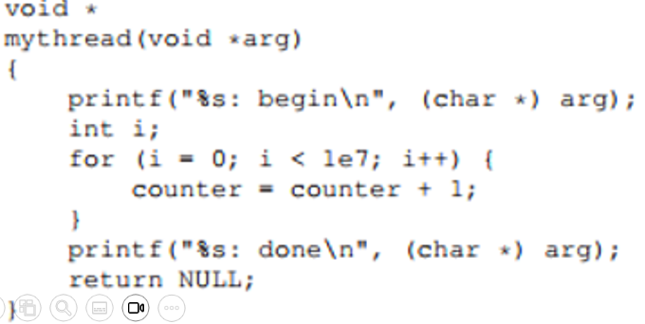
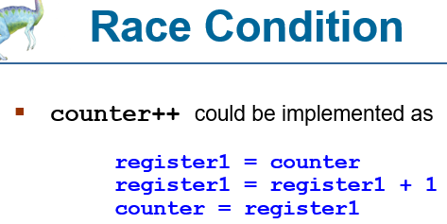
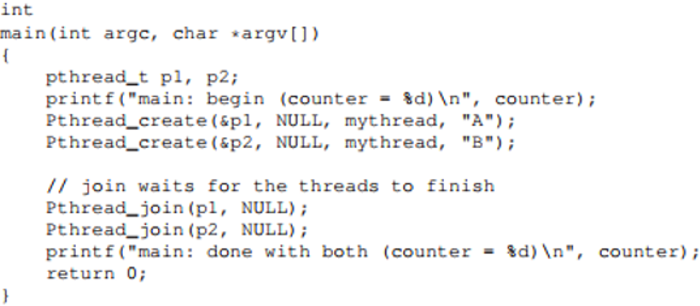
Global Variable

Slide 4
Implicit Threading
Growing in popularity as numbers of threads increase, program correctness more difficult with explicit threads
Creation and management of threads done by compilers and run-time libraries rather than programmers
Five methods explored
Thread Pools
Fork-Join
OpenMP
Grand Central Dispatch
Intel Threading Building Blocks

Slide 5
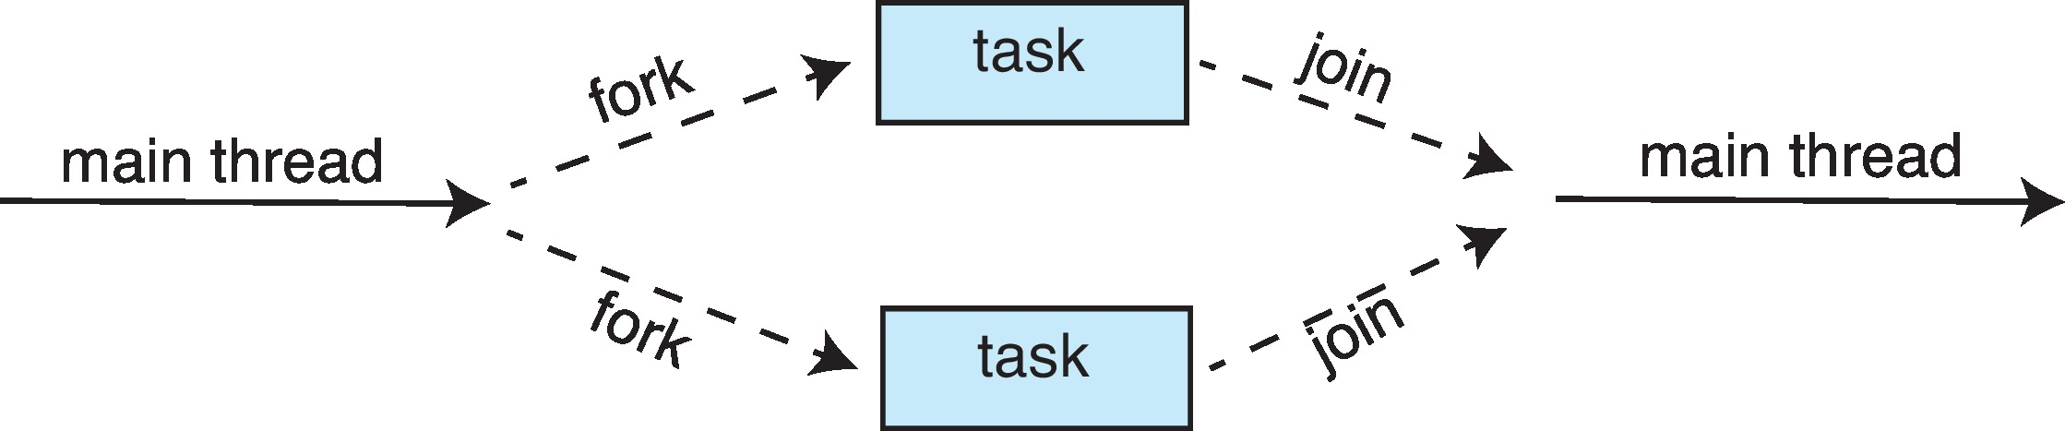
Fork-Join Parallelism
Multiple threads (tasks) are forked, and then joined.
Fork-join parallelism is a programming model and parallel computing paradigm that involves splitting ("forking") a task into multiple subtasks, which are then executed concurrently across multiple processing units (e.g., CPU cores or threads). Once all subtasks have completed their execution, the results are combined ("joined") to produce the final result.

Slide 6
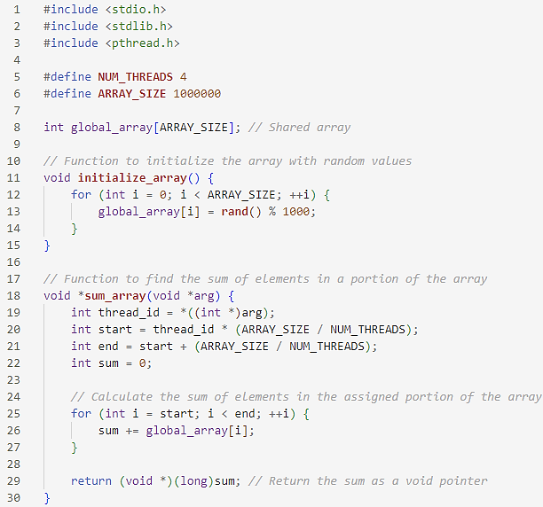
Fork-Join Parallelism

Slide 7
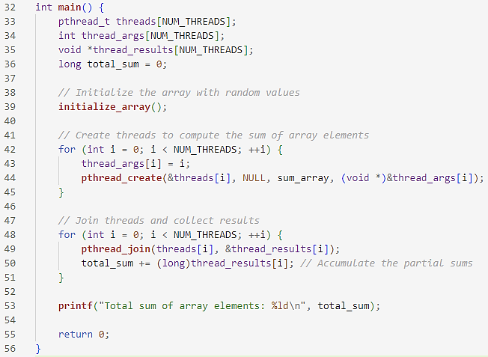
Fork-Join Parallelism

Slide 8
Threading Issues
Semantics of fork() and exec() system calls
Signal handling
Synchronous and asynchronous
Thread cancellation of target thread
Asynchronous or deferred
Thread-local storage

Slide 9
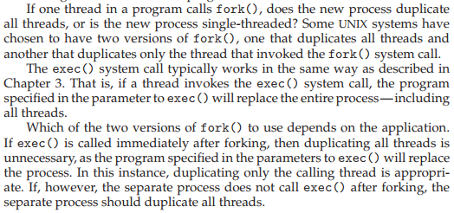
Semantics of fork() and exec()
Does fork()duplicate only the calling thread or all threads?
Some UNIXes have two versions of fork
exec() usually works as normal – replace the running process including all threads

Slide 10


Signal Handling
Signals are used in UNIX systems to notify a process that a particular event has occurred.
A signal handler is used to process signals
Signal is generated by particular event
Signal is delivered to a process
Signal is handled by one of two signal handlers:
default
user-defined
Every signal has default handler that kernel runs when handling signal
User-defined signal handler can override default
For single-threaded, signal delivered to process

Slide 11
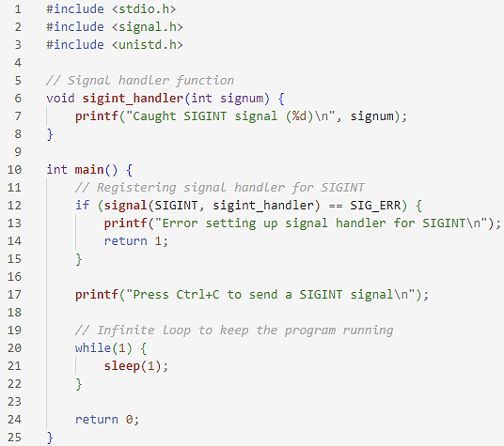
Signal Handling (Cont.)

Slide 12
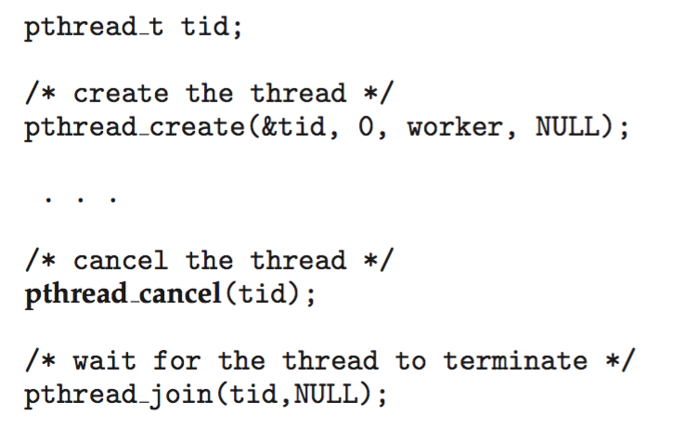
Thread Cancellation
Terminating a thread before it has finished
Thread to be canceled is target thread
Two general approaches:
Asynchronous cancellation terminates the target thread immediately
Deferred cancellation allows the target thread to periodically check if it should be cancelled
Pthread code to create and cancel a thread:

Slide 13
Thread-Local Storage
Thread-local storage (TLS) allows each thread to have its own copy of data
Useful when you do not have control over the thread creation process (i.e., when using a thread pool)
Different from local variables
Local variables visible only during single function invocation
TLS visible across function invocations
Similar to static data
TLS is unique to each thread

Slide 14
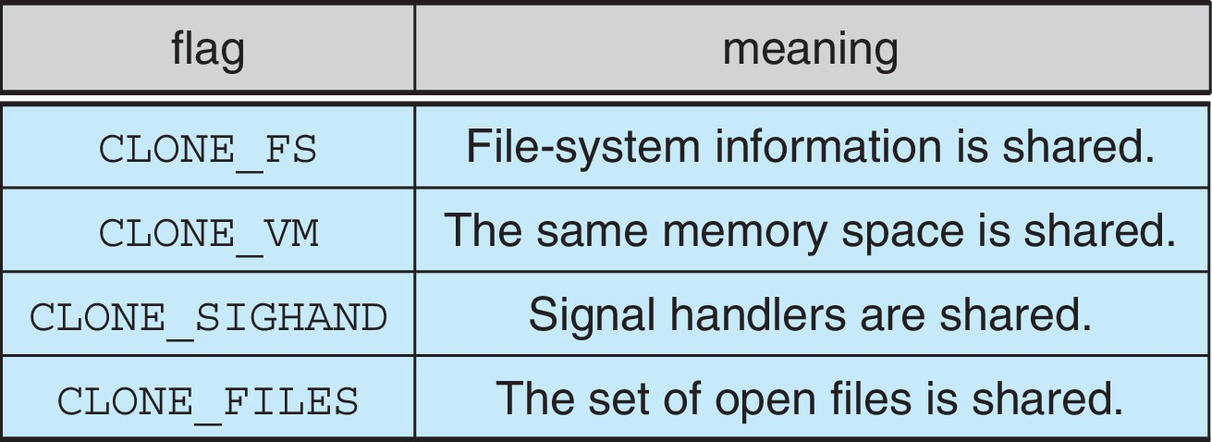
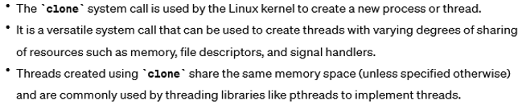
Linux Thread Creation System call
Linux refers to them as tasks rather than threads
Thread creation is done through clone() system call
clone() allows a child task to share the address space of the parent task (process)
Flags control behavior

Slide 15

On most modern operating systems, it is kernel-level threads—not processes—that are being scheduled by the operating system.
User-level threads are managed by a thread library, and the kernel is unaware of them. To run on a CPU, user-level threads must ultimately be mapped to an associated kernel-level thread, although this mapping may be indirect and may use a lightweight process (LWP).

Slide 16
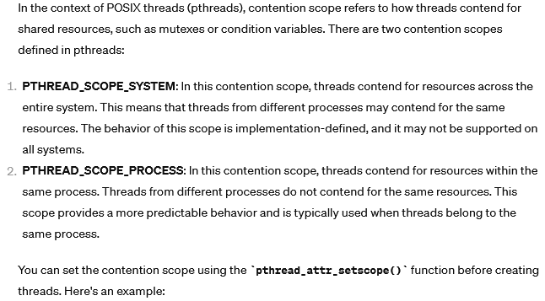

Slide 17
Chapter 6: Synchronization Tools

Slide 18
Background
Processes can execute concurrently
May be interrupted at any time, partially completing execution
Concurrent access to shared data may result in data inconsistency
Maintaining data consistency requires mechanisms to ensure the orderly execution of cooperating processes
We illustrated in chapter 4 the problem when we considered the Bounded Buffer problem with use of a counter that is updated concurrently by the producer and consumer,. Which lead to race condition.

Slide 19
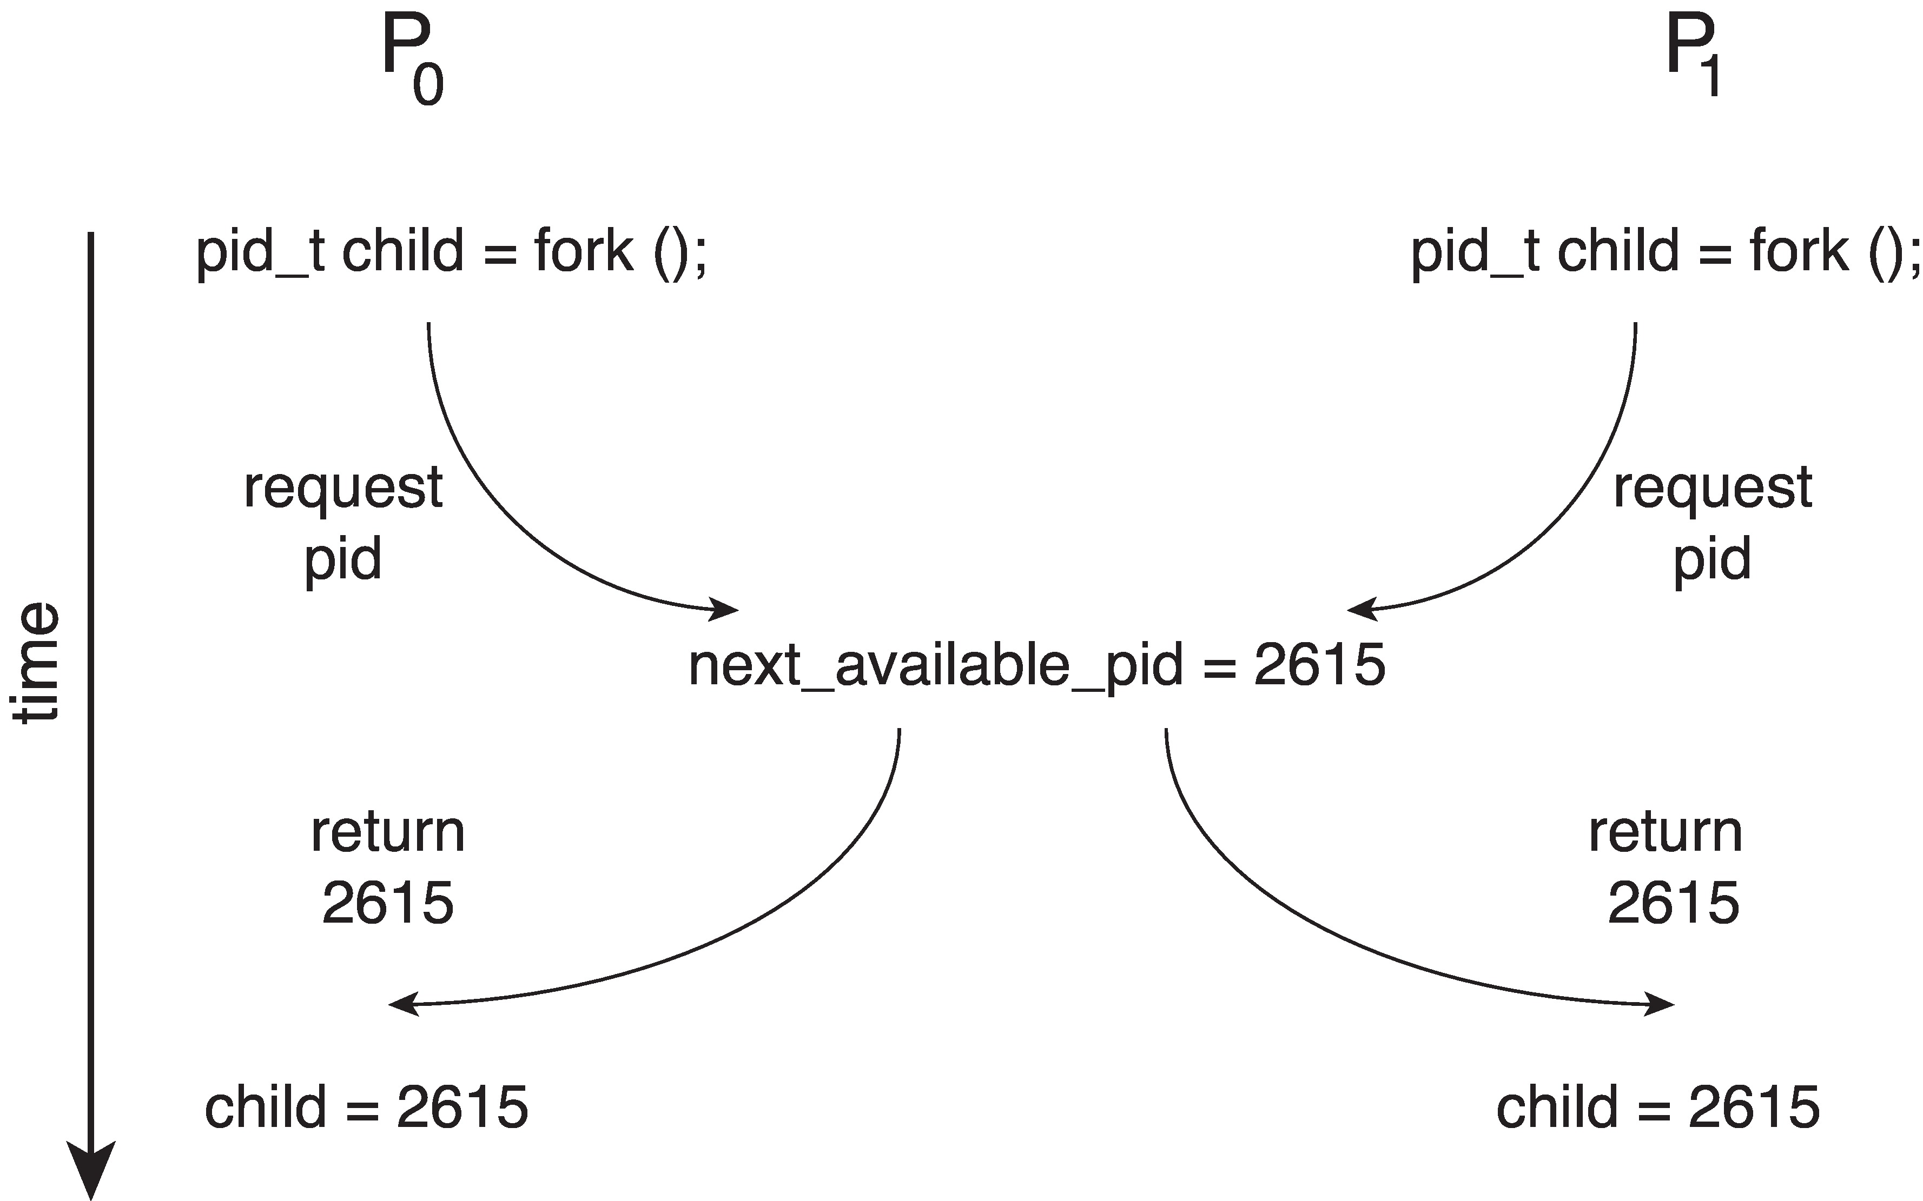
Race Condition
Processes P₀ and P₁ are creating child processes using the fork() system call
Race condition on kernel variable next_available_pid which represents the next available process identifier (pid)
Unless there is a mechanism to prevent P₀ and P₁ from accessing the variable next_available_pid the same pid could be assigned to two different processes!

Slide 20
Race Condition

